Slide 1
Proyecto redes neuronales
Juan Alberto Gutiérrez Canto

Slide 2
Capas
Entradas 32x32=1024
Ocultas 10
Salida 10
Entrenamiento
Archivo entrenamiento.txt
Pesos inciales 0.001

Slide 3
Pesos iniciales
0.0004200000
0.0046800000
0.0033500000
0.0050100000
0.0017000000
0.0072500000
0.0047900000
0.0035900000
0.0096300000
0.0046500000
0.0070600000
0.0014600000
0.0028200000
0.0082800000
0.0096200000
0.0049200000
0.0099600000
0.0094300000
0.0082800000
0.0043700000
0.0039200000
0.0060500000

Slide 4
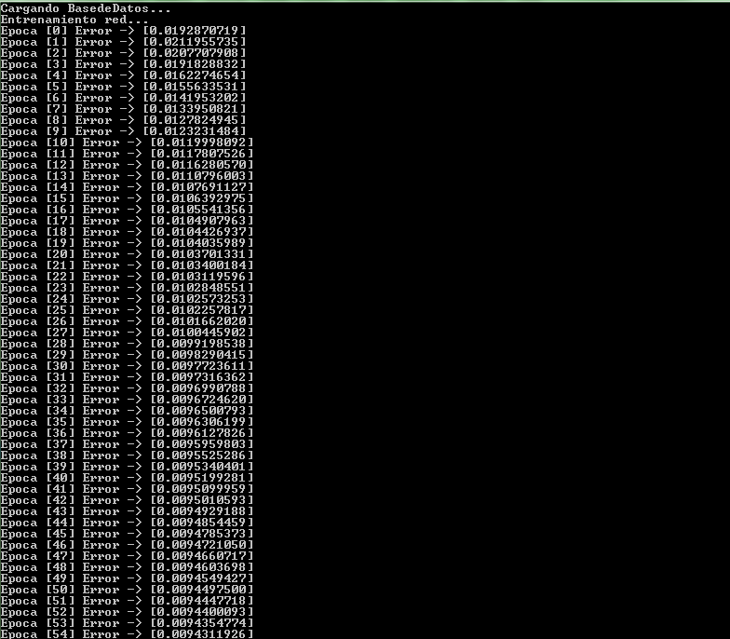

Slide 5
Aprendizaje
Tolerancia PromedioError > 0.000001
3 ½ horas

Slide 6
Pesos finales
-4.8701242891
0.0046800000
0.0033500000
0.0050100000
0.0017000000
0.0072500000
0.0047900000
0.0035900000
0.0096300000
0.0209822505
-0.0261982129
-0.0634668842
0.0243701469
0.1163024573
-0.0067413738
0.0224847845
-0.0183491097
-0.0438457447
0.0065594657
-0.1264234696
-0.0045057108
-0.0087516430
-0.0195480746
-0.0430243874
0.0001746927
-0.0005321554
0.0060727904
0.0055252950
0.0058536065
0.0089600000
0.0039190795
0.0072700000
0.0077200000
0.0053900000
0.0087000000
0.0091300000
0.0066800000
0.0030000000
0.0003600000
0.0103374262
0.0229119166
0.0115293397
-0.1009887134
0.0502107733
-0.0060894549
-0.0283126195
-0.0164370281
-0.1107832759
-0.1365202881
-0.1216086159
-0.1050824705
-0.1329779734
-0.1215034370
-0.0801552821

Slide 7
Prueba
1700 casos
Archivo prueba.txt
Matriz de confusión
Precisión 80.0324%

